Slide 1

Histograms
By: Aaronea Wiggins
CTEC 298 – Dr. Bemley
April 22, 2025
Plot Presentation

Slide 2
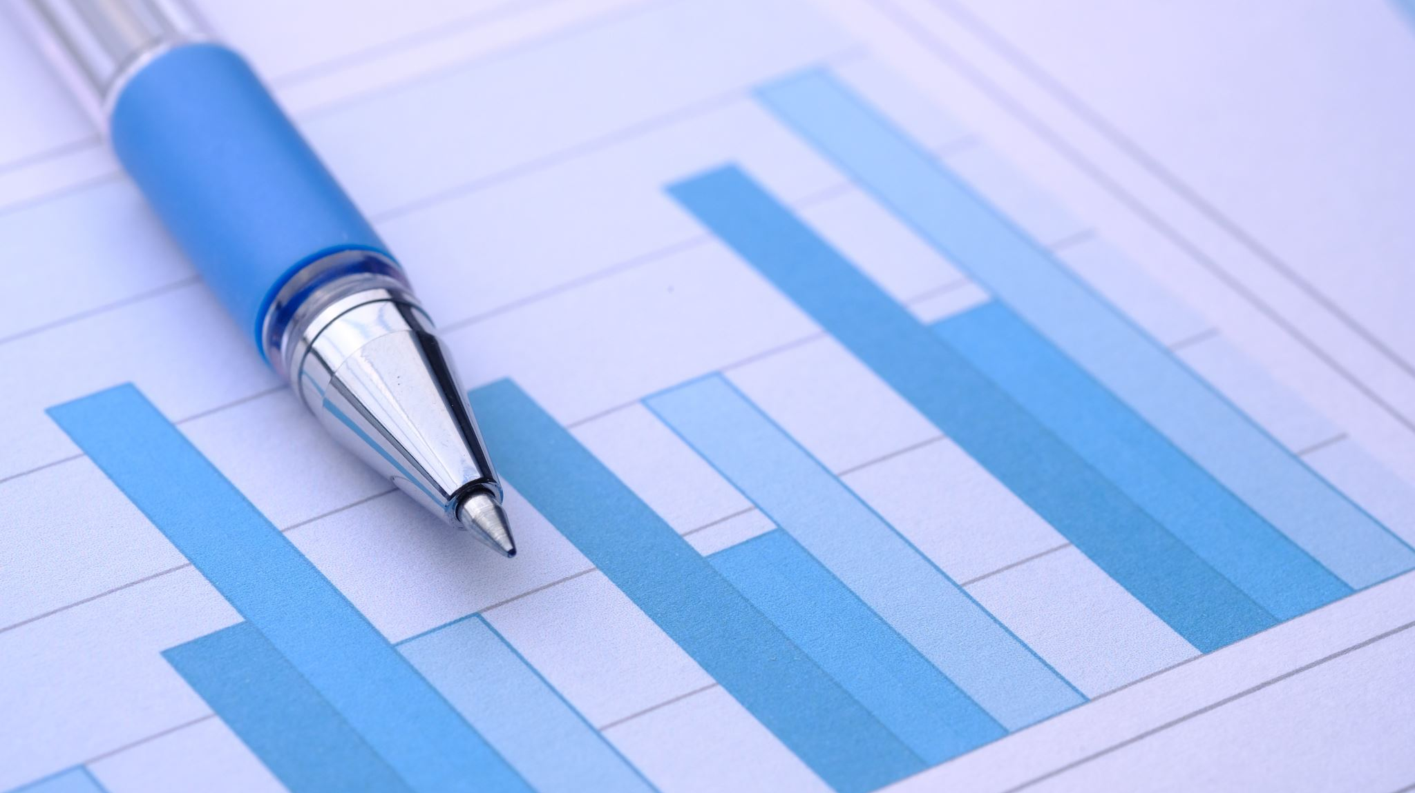
Introduction to data
Hello everyone,
My name is Aaronea Wiggins and today I will be presenting on Histograms

Slide 3
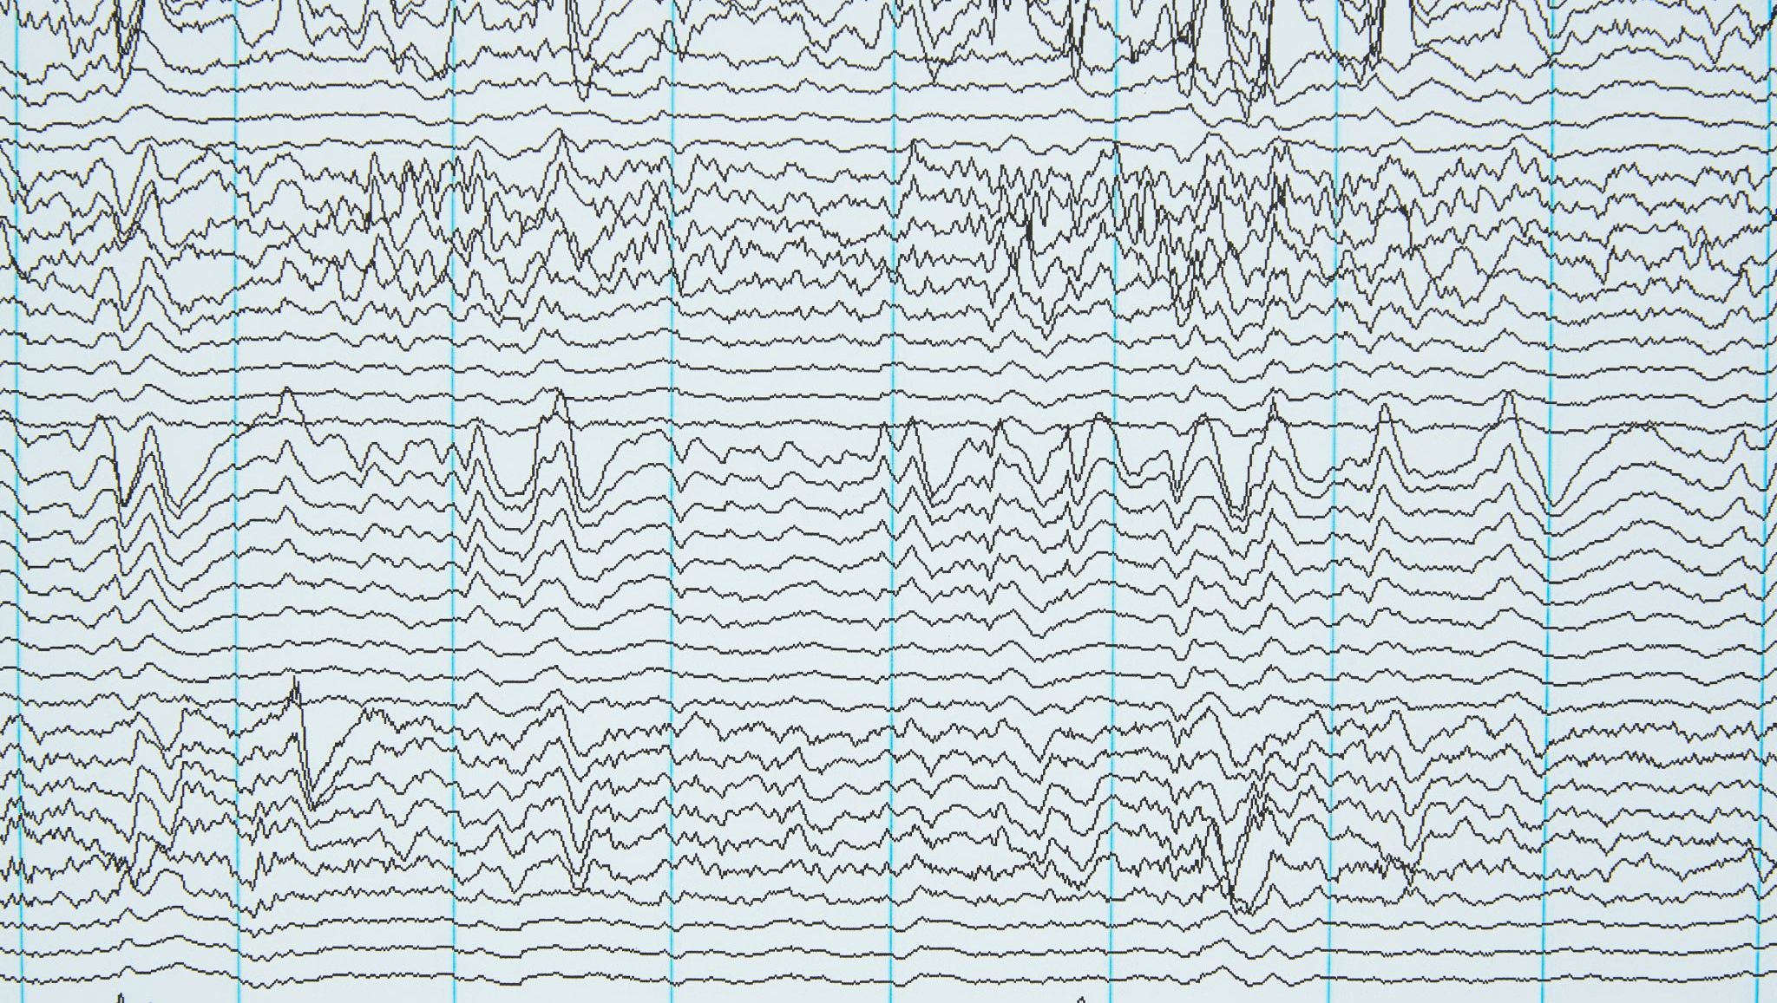
What are Histograms plots?
Like other graphs, charts, and plots--A Histogram is a visual reputation of data. With the similar visual of a bar graphs, Histograms typically differ from bar graphs by having no spaces in between the plotted data with the use of categorical bins and range.

Slide 4
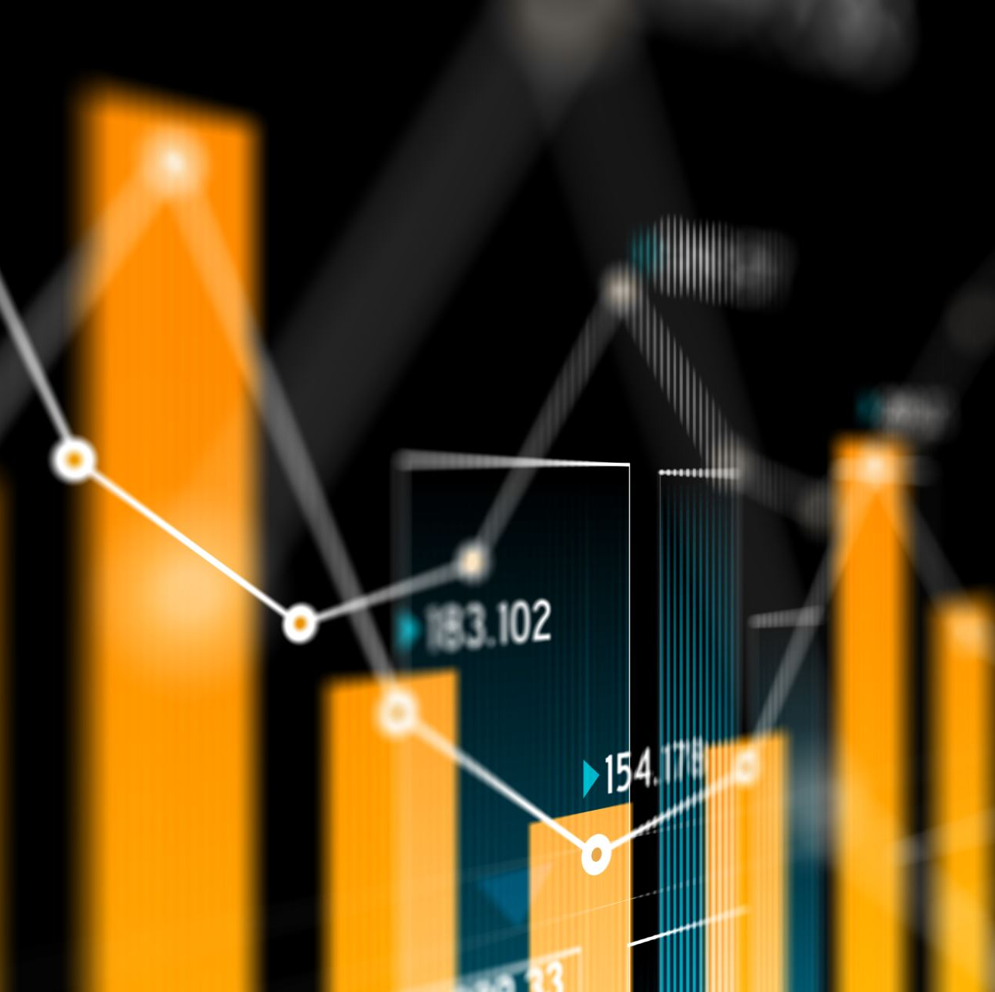
How Histogram Plots work
Dataset→ ranges(frequency) → bins(width)
First, select a graphing application of your choice. (Excel in this case)
Next, What information are you looking for? (Juvenile arrests by race in 2020, and offense type).
Lastly, label your title, x-axis and y-axis, and plot your dataset.

Slide 5

Python Code for a Histogram chart
# Aaronea Wiggins Histogram plot - CTEC 298 |
import matplotlib.pyplot as plt
# Details of Dataset
categories = ['Black', 'White', 'Pacific Islander', 'American Indian', 'Asian']
values = [728044, 1676290, 2404334, 48587, 30845]
# Plot
plt.figure(figsize=(10, 6))
plt.bar(categories, values, color='lime green', edgecolor='black')
# X-axis and Y-axis titles and Title of overall Histogram plot
plt.xlabel('Race')
plt.ylabel('Amount of crimes per race')
plt.title('2020 Juvenile Crimes')
# Show plot results
plt.tight_layout()
plt.show()

Slide 6
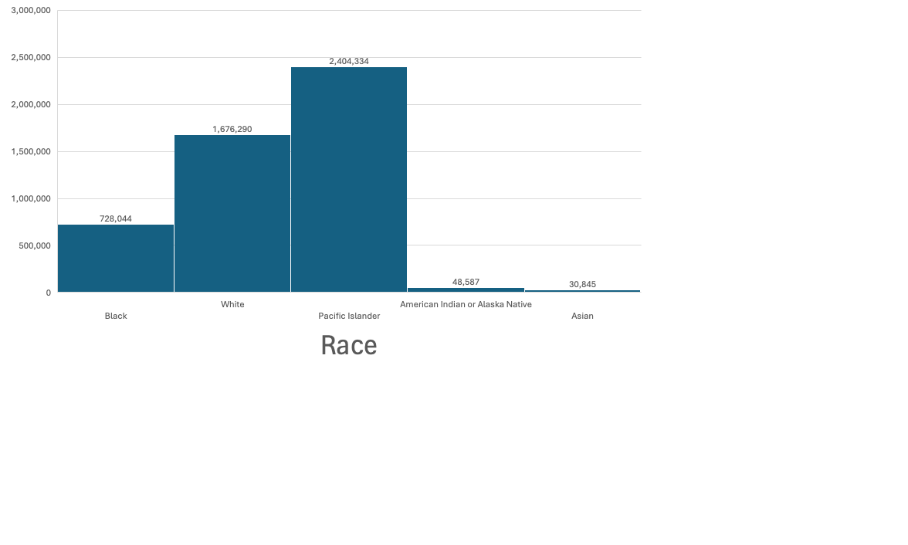
Why are Histograms relevant?
Histogram title
Y-axis label
X-axis label

Slide 7
References
Arrests by offense, age, and race | Office of Juvenile Justice and Delinquency Prevention. (n.d.). https://ojjdp.ojp.gov/statistical-briefing-book/crime/faqs/ucr_table_2 – filtered by age/year
Matplotlib

